Slide 1
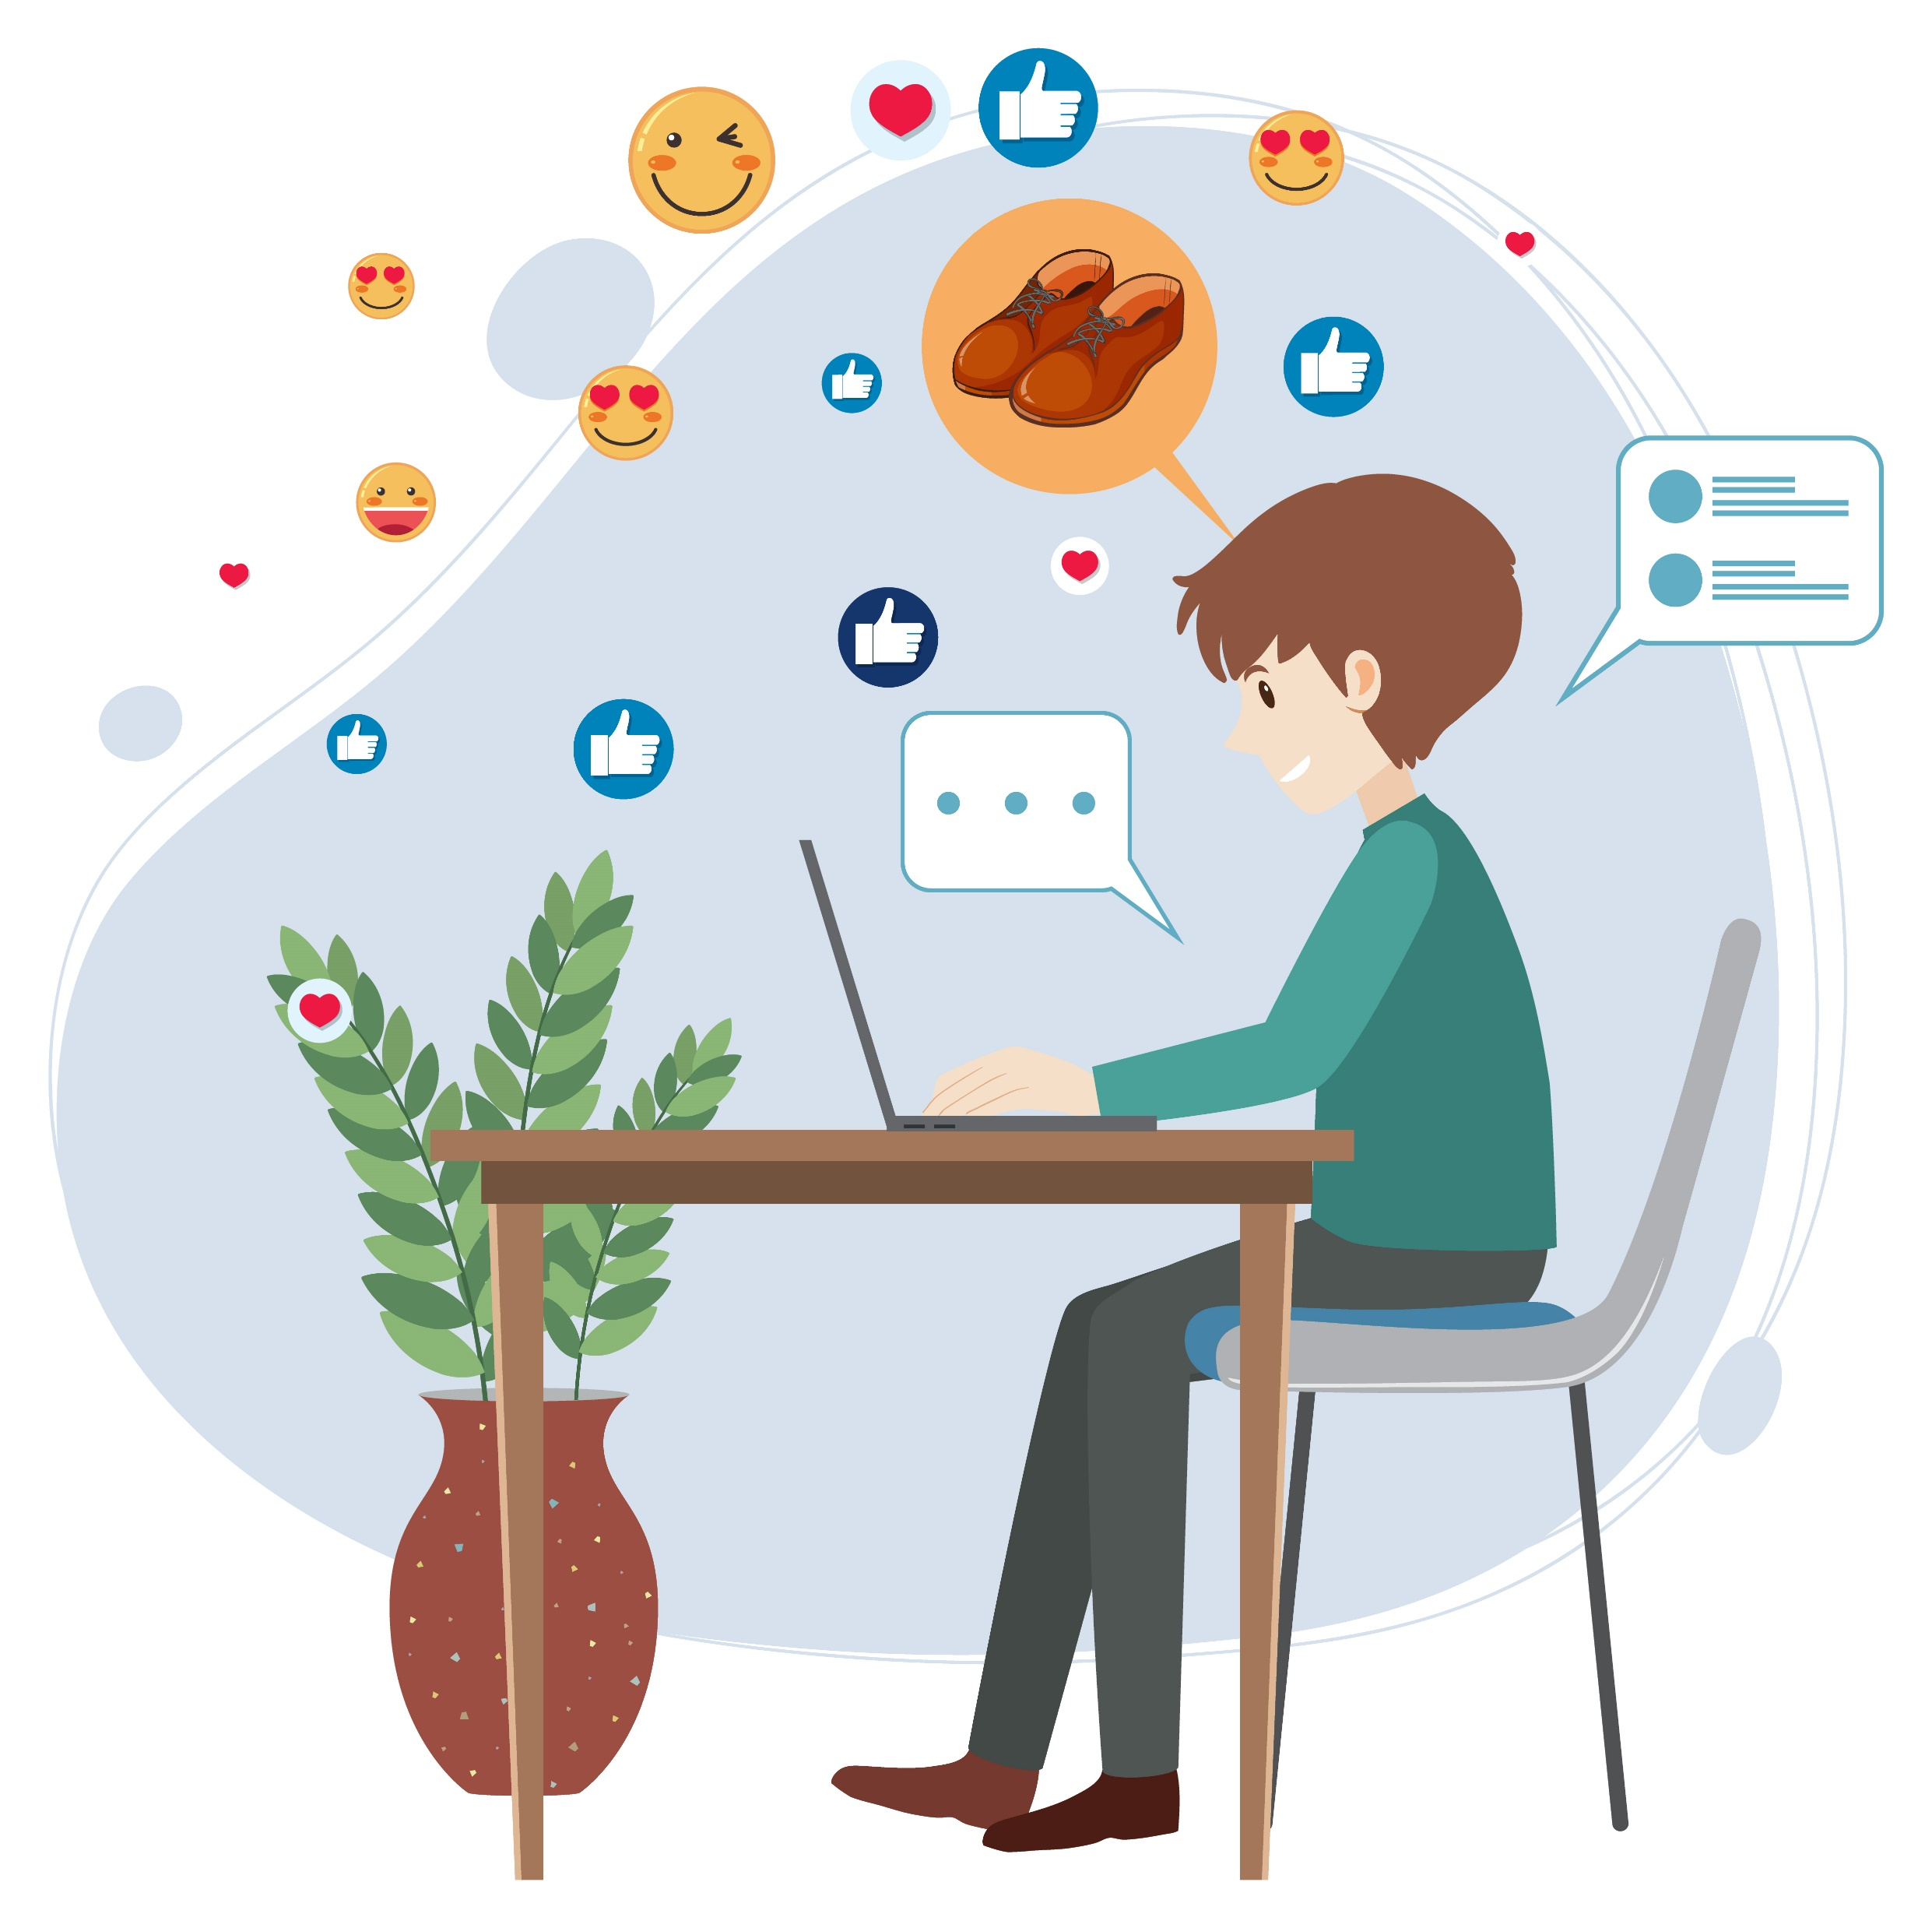
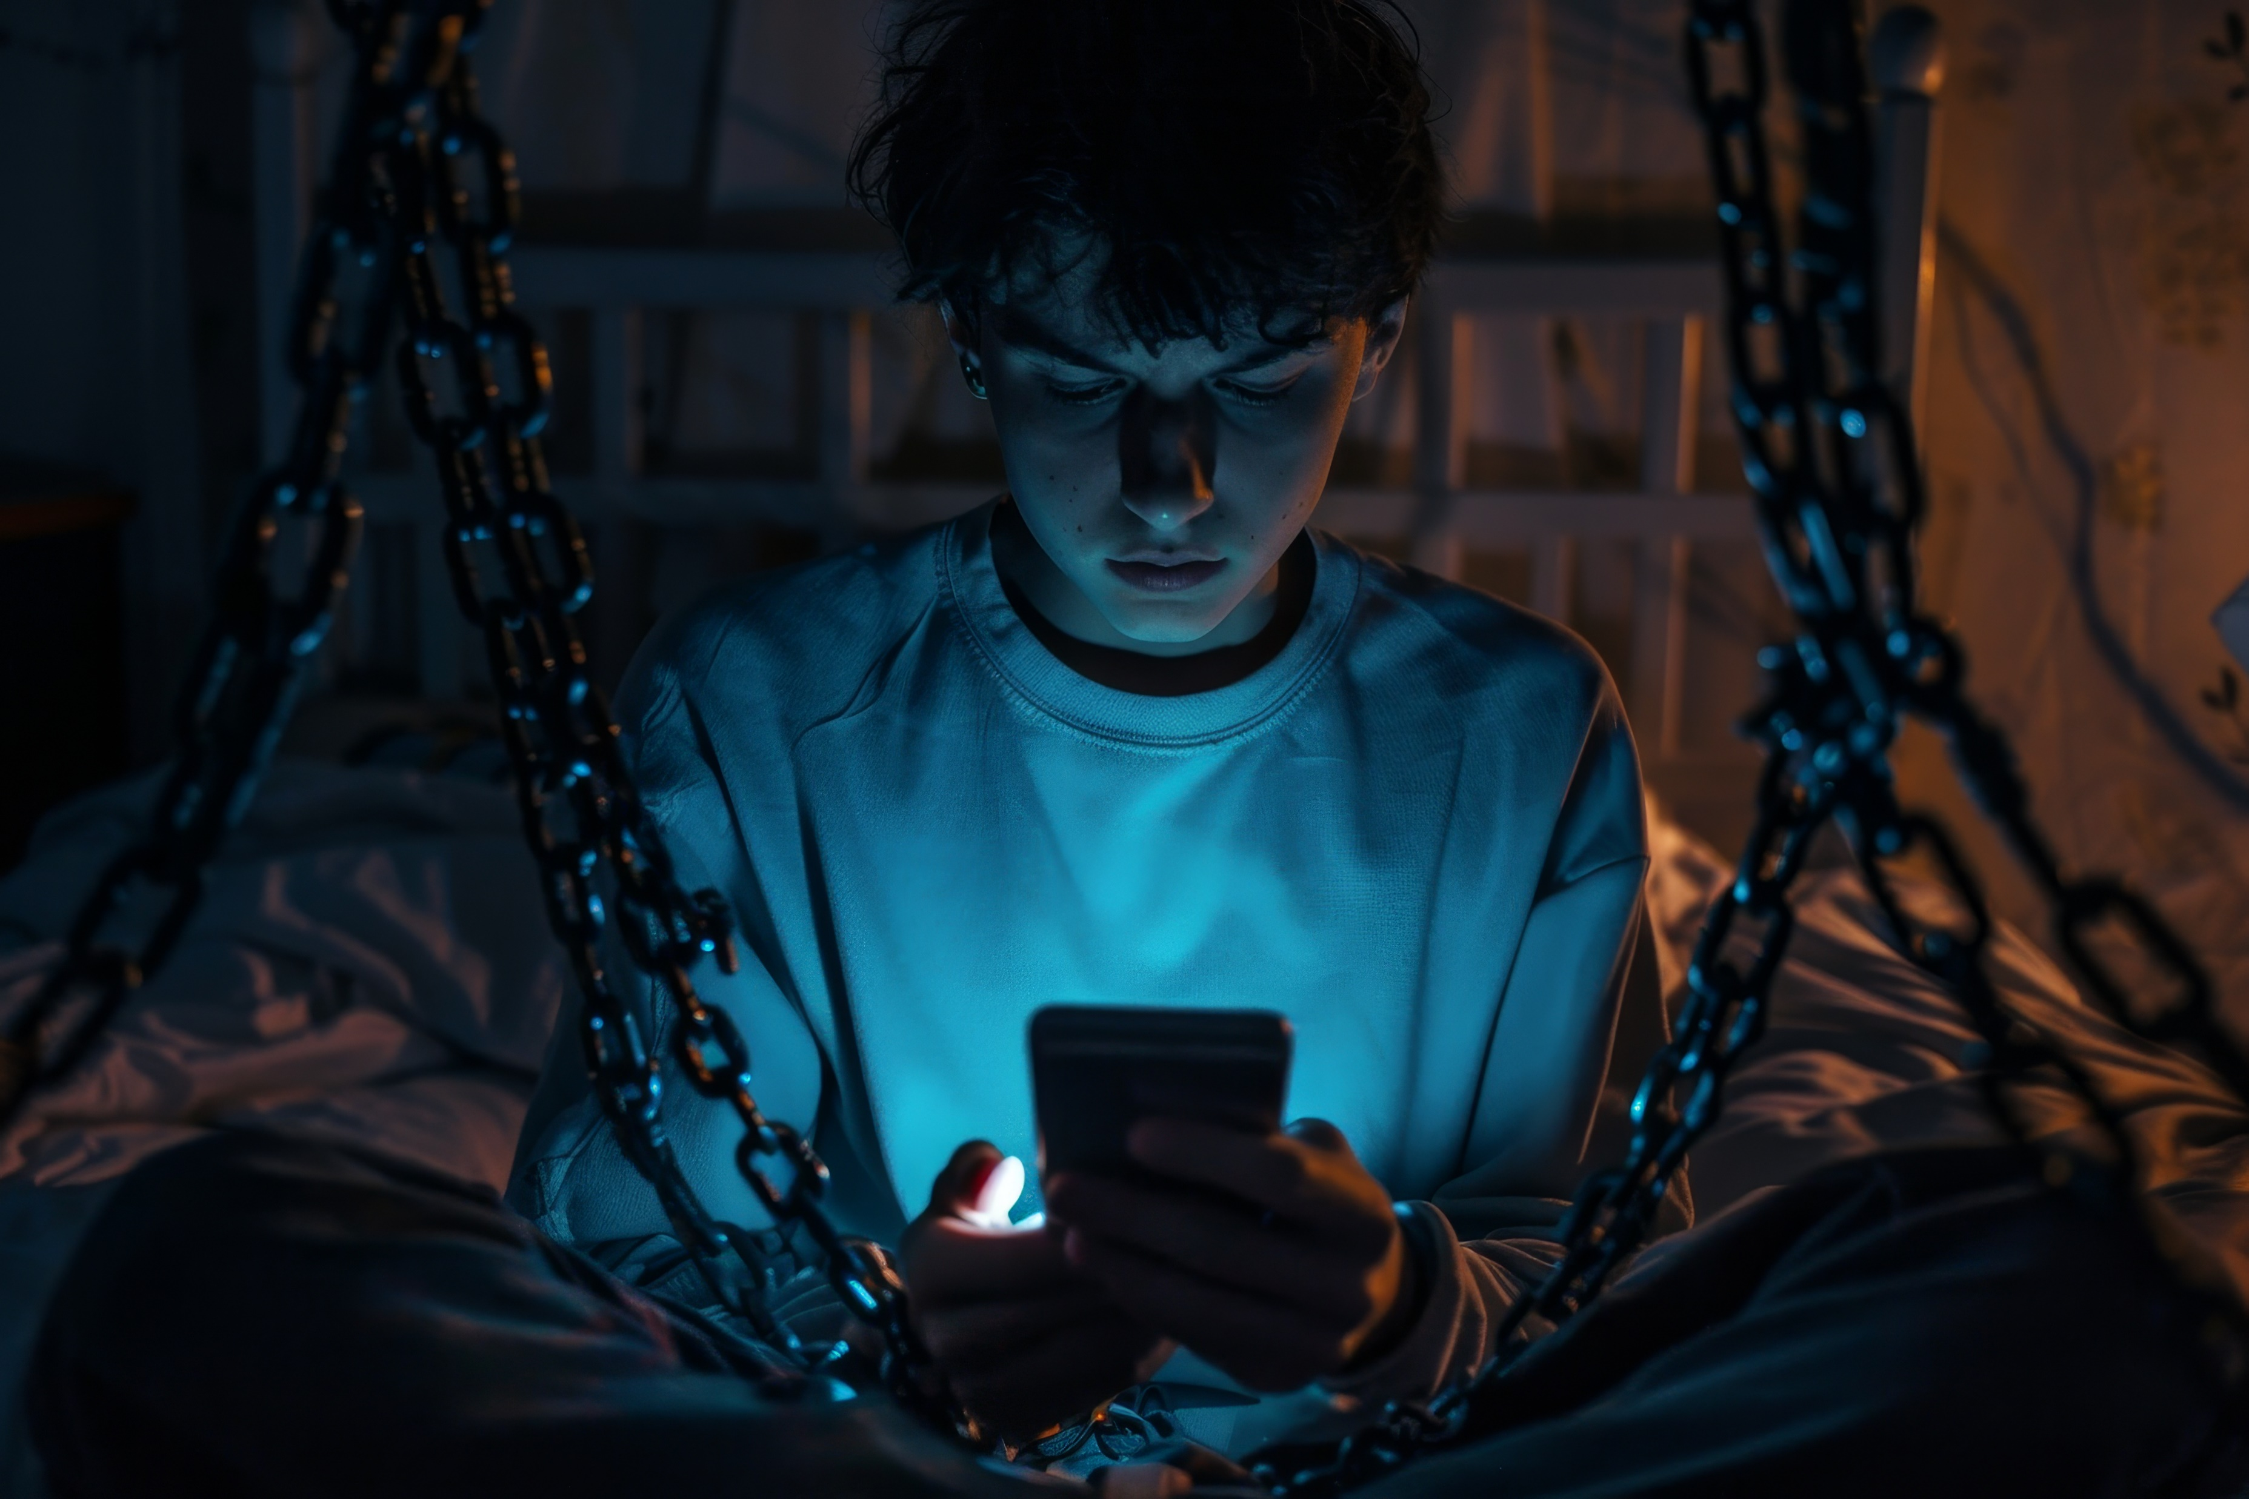
THE IMPACT OF SOCIAL MEDIA ON SOCIETY
Connecting THE WORLD – FOR BETTER OR WORSE

Slide 2
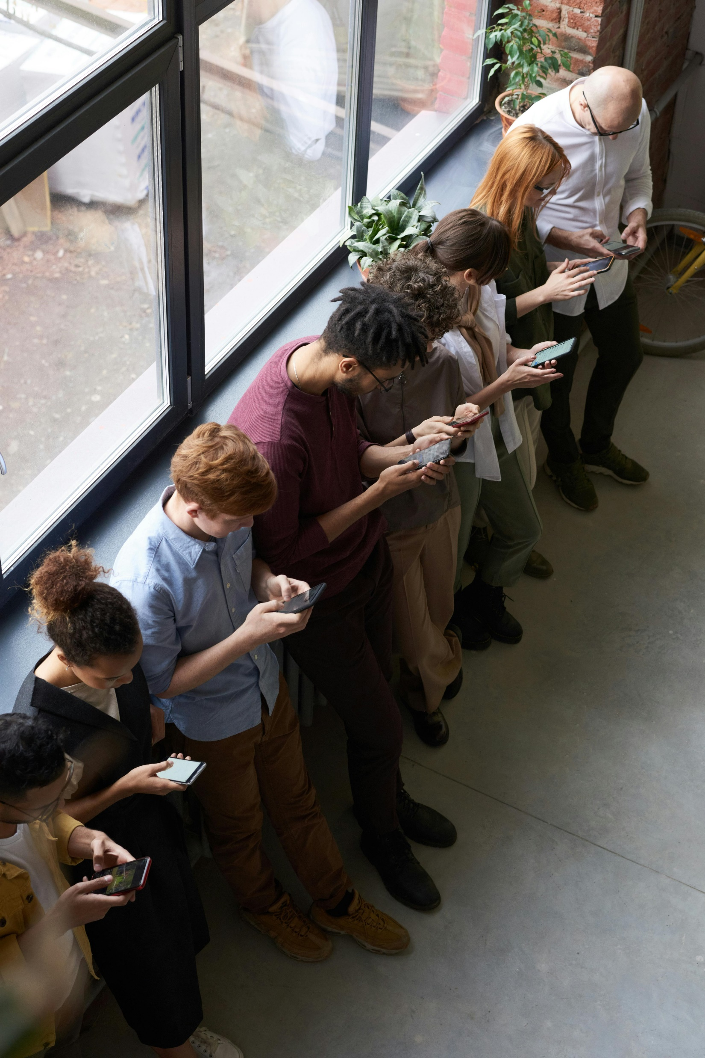
WHAT IS SOCIAL MEDIA
Social media is a form of digital communication that allows users to form online networks and communities for socializing, sharing information, and posting user-created content.
Early social media platforms, such as MySpace and LiveJournal, were designed for people to connect with friends and family. MySpace, which allowed users to create personal profile pages and share information about themselves, became the first network to reach one million active monthly users in 2004.
There were 5.41 billion social media users around the world at the start of July 2025, equating to 65.7 percent of the total global population. (source)

Slide 3

BENEFITS OF SOCIAL MEDIA
Social media has significantly improved relationships by providing a constant and instant communication platform, allowing people to stay connected regardless of geographical distance. So, the first benefit of social media is definitely communication!
Companies can use social media to implement low-cost marketing plans. With the help of tools for targeted advertising, social media platforms like Facebook and Instagram can connect with customers directly, access niche markets, and raise brand awareness.
One of the pros of social media is that it provides free knowledge. Social media gives users access to various educational resources and content, making it a valuable educational tool. By exchanging expertise, tutorials, and courses, professionals and educational institutions increase accessibility to learning.

Slide 4
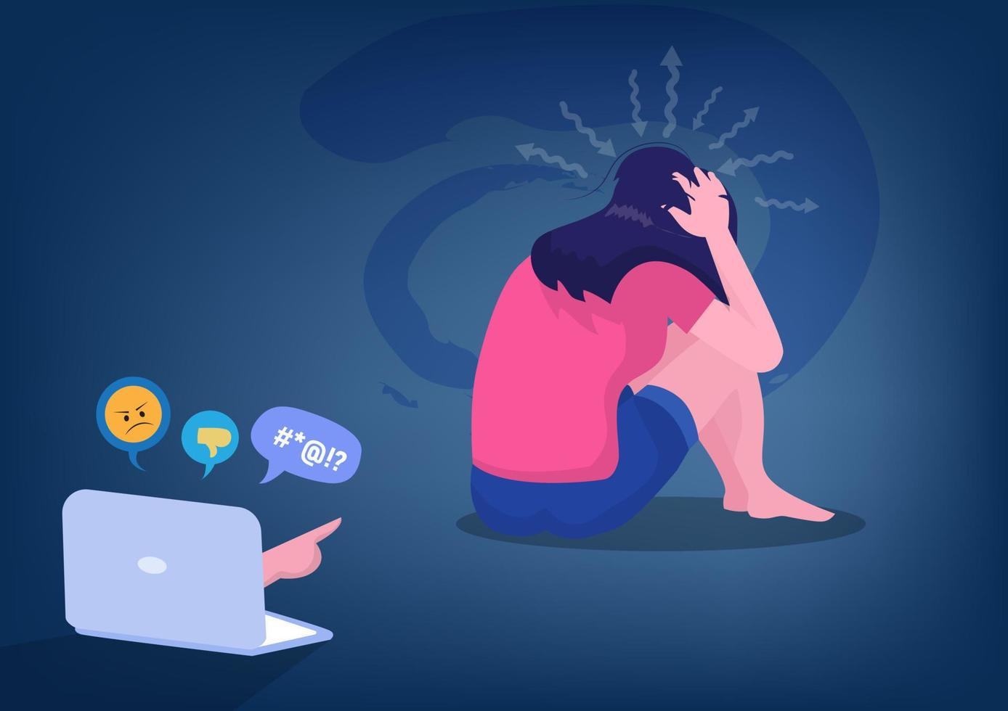
CHALLENGES AND RISKS
One of the cons of social media is that it brings many privacy and security concerns. Personal information that users share on social media platforms is frequently vulnerable to exploitation if inadequate security measures are in place. Significant hazards include unauthorized access to personal information and data breaches.
One of the other cons of social media is misinformation. Due to the quick diffusion of information on social media, false or misleading information may also increase. This may result in confusion, rumours, and adverse effects on public opinion and conduct.
Cyberbullying and harassment can occur on social media. On these sites, anonymity might encourage people to act harmfully, which can upset victims emotionally.

Slide 5
SOCIAL MEDIA STATS WORLDWIDE
Source: statcounter GlobalStats

